Slide 2
Topic: Measurement
EQ: How do we calculate the volume of cylinders, spheres and pyramids?
Get your VIVO’s
Topic and EQ in Interactive Notebook
NO PHONES OR EAR BUDS
2 topic and EQ’s today
Notes:
Explaining this slide: Demonstrate the “type of response”: In 2 minutes (timed), you are going to share with your shoulder partner all of the formulas and examples you have written. You will get 2 mins (timed) to write down any formula/examples that your partners has that you haven’t and vice-versa. You and your partner then need to be prepared to share one formula and example on the board ( only choose 3 )
After marking the roll:
- Use active scanning and intervene if they are not. Use Private dialogue if needed

Slide 3
24
7
30
Date
Topic : Measurement
EQ: How do we calculate the volume of cylinders, spheres and pyramids?
How do I calculate the volume of a cylinder?
V = πr²h
h
r
Find the volume and surface area of the cylinder below.
10 m
2 m
m²
V = 125.6
m³
S.A = 150.72
Notes:
Need to bring a rectangular and triangular prism to show identical cross section

Slide 4
24
7
30
Date
Topic : Measurement
EQ: How do we calculate the volume of cylinders, spheres and pyramids?
How do I calculate the volume of a sphere?
r
V = (4/3)π r³
Find the volume and surface area of the sphere below.
9 in.
S.A = 4π (9)²
S.A = 1017.36
in.³
V = (4/3)π(9)³
V = 3052.08
in.³
Notes:
Need to bring a rectangular and triangular prism to show identical cross section

Slide 5
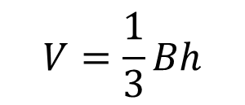
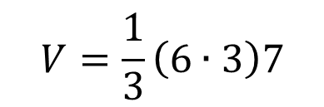

24
7
30
Date
Topic : Measurement
EQ: How do we calculate the volume of cylinders, spheres and pyramids?
How do I calculate the volume of a pyramid?
The volume V of a pyramid with height h and base of area B is given by the formula:
Note: B represents the area of the base (l w).
Find the volume of the pyramid (rectangular base) below.
7 cm
3 cm
6 cm
cm³
Notes:
Need to bring a rectangular and triangular prism to show identical cross section

Slide 7
Independent work
Now complete exercise 11 on pages 37-39 in MAWA Essentials Units 3&4
Keep working on your formula card and examples card in preparation for the test

Slide 8
24
7
30
Date
Topic : Measurement
EQ: How do we calculate the volume of cylinders, spheres and pyramids?
How do I calculate the volume of a cylinder?
Notes:
Need to bring a rectangular and triangular prism to show identical cross section

